Slide 1
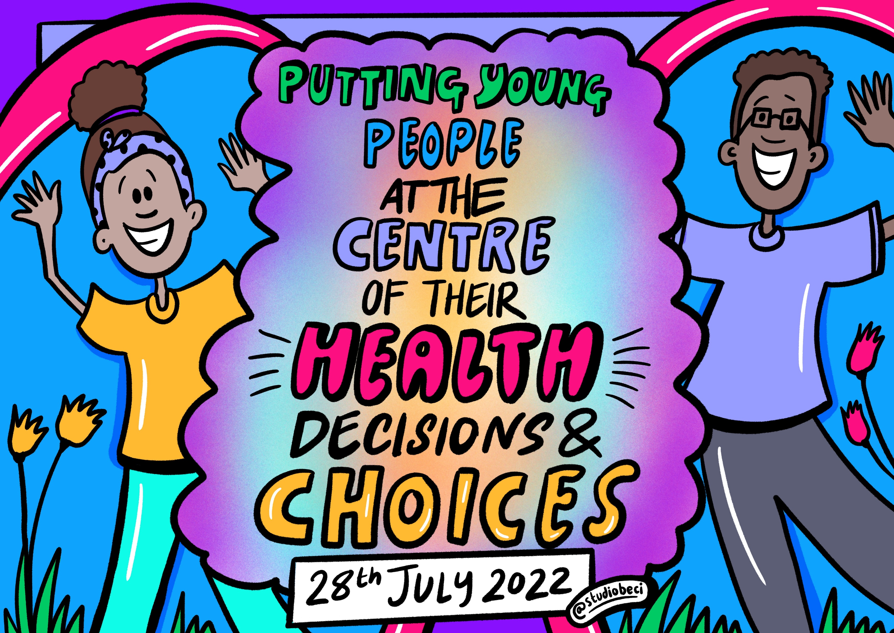
All illustrations in this presentation are created by Beci Ward and can be saved and shared by partners, crediting their creator in the below:
Artwork by Beci Ward, Studio Beci
You can also download additional illustrations here.

Slide 2
Themes from workshops

Slide 3
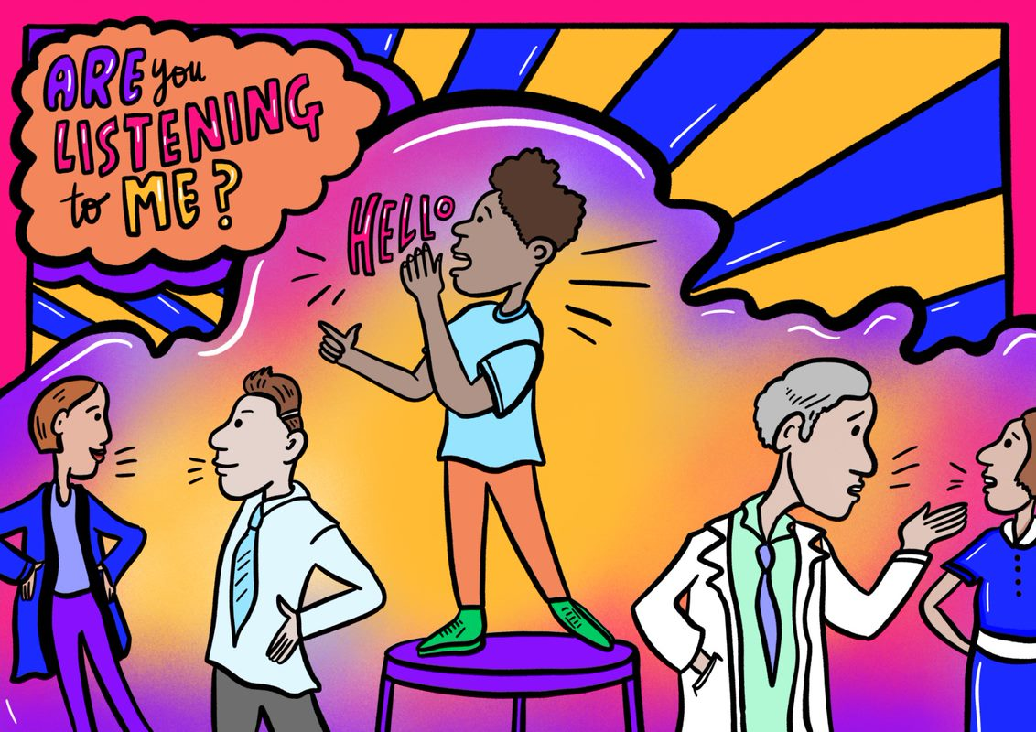
Theme 1: Young people don’t feel listened to or valued by healthcare professionals, which causes mistrust and delays seeking help.

Slide 4
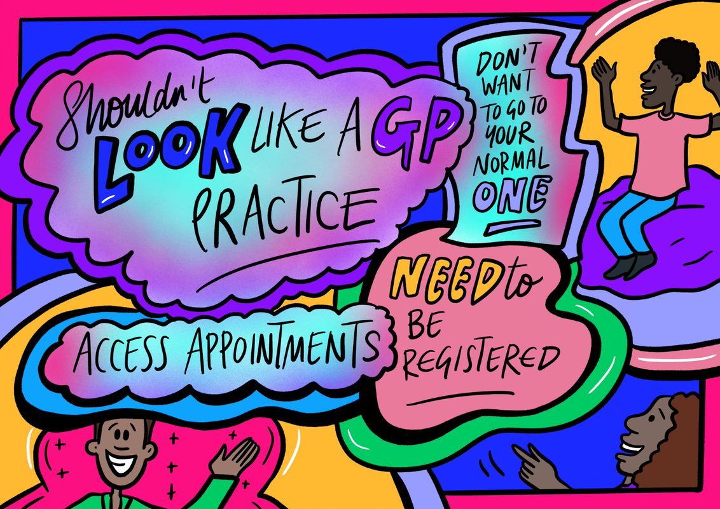
Theme 2: Being in a traditional health care environment can be stressful for young people. Most prefer to seek care in alternate / more comfortable environments.

Slide 5
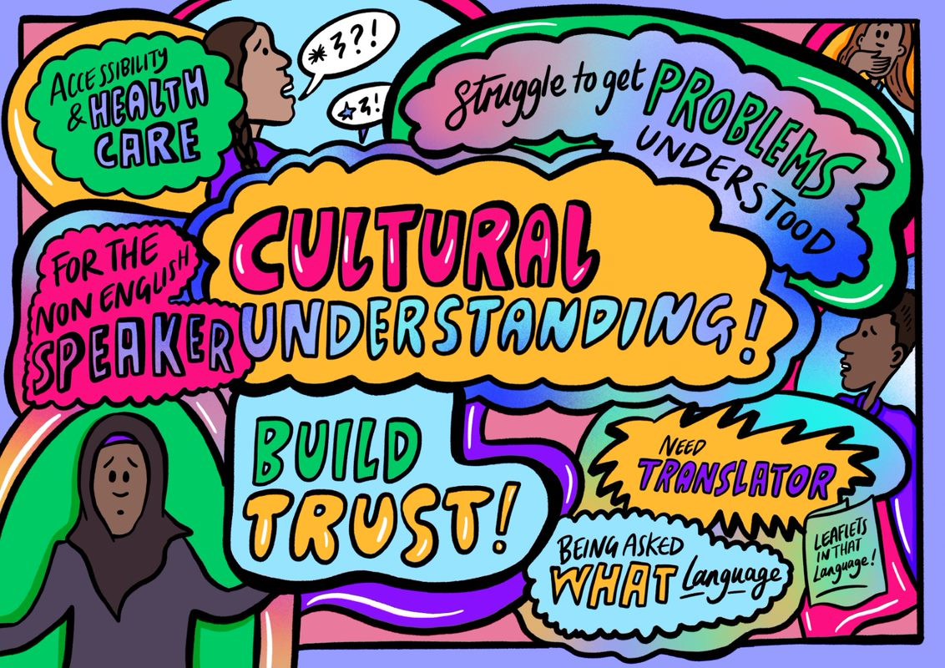
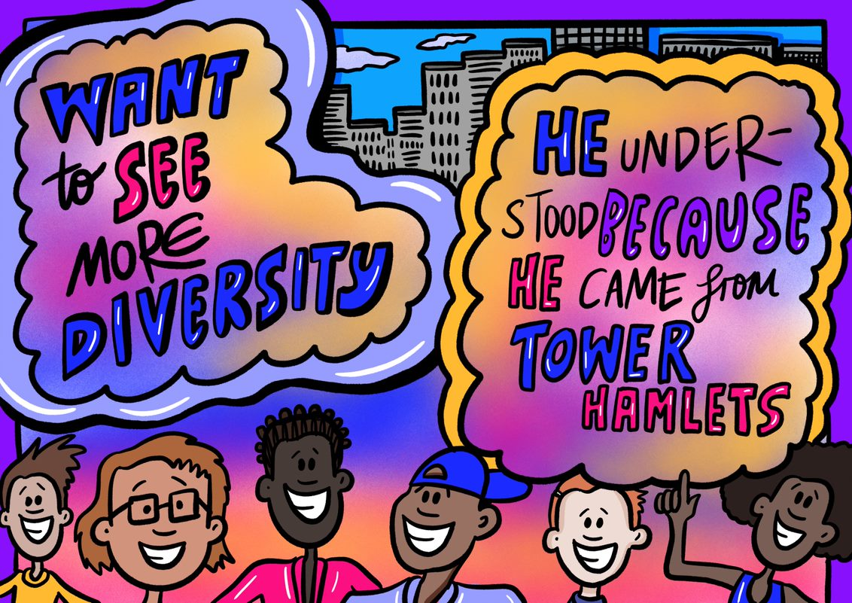
Theme 3: More diversity is needed within health care system and training is needed to provide better care to all races, ethnicities, gender identities, backgrounds, ages, and cultures.

Slide 6
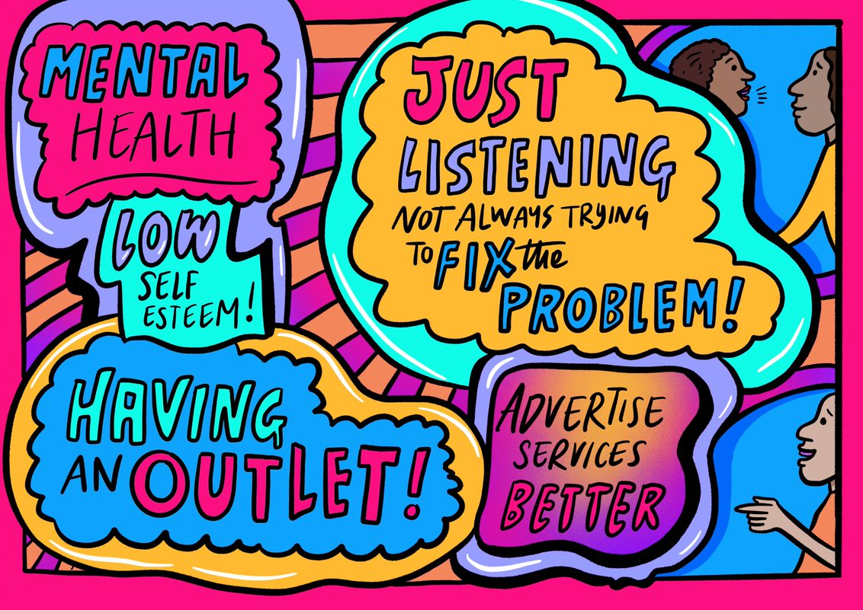
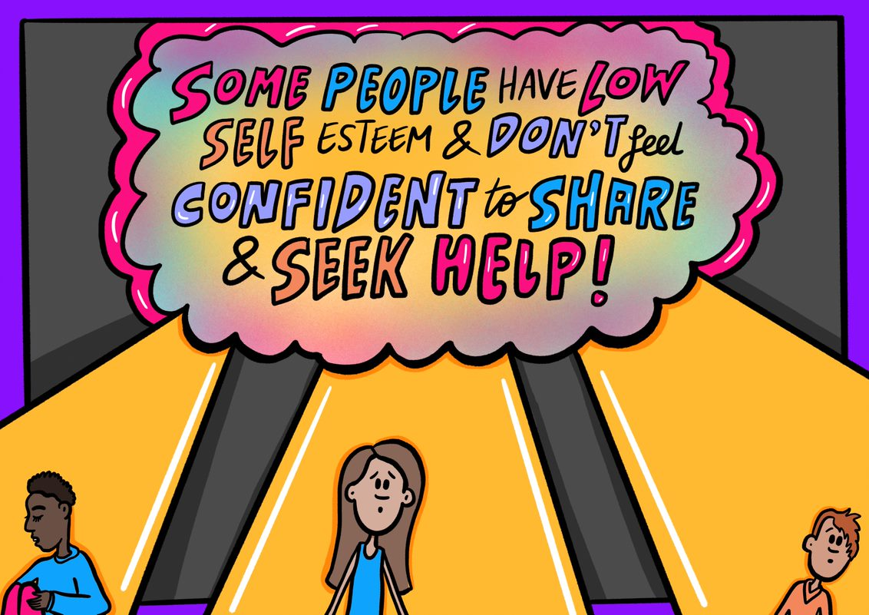
Theme 4: Healthcare professionals should take a compassionate and holistic approach to helping young people, valuing the importance of mental health.

Slide 7
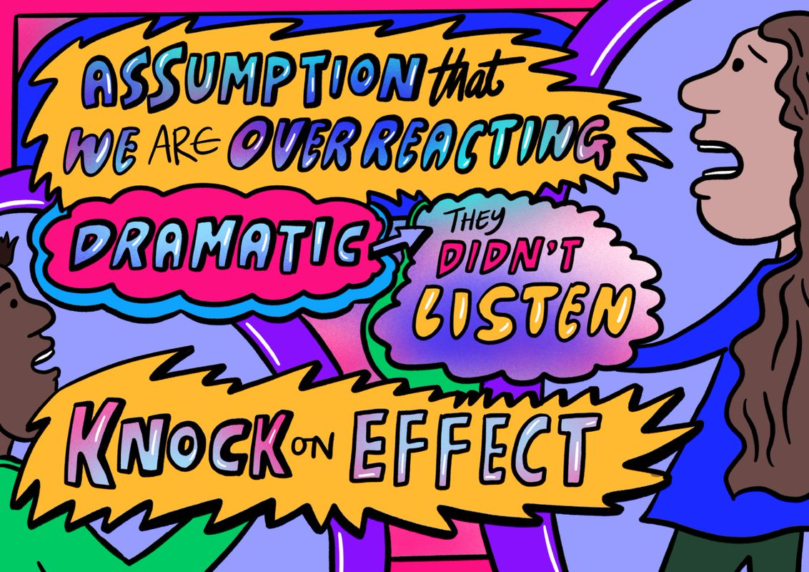
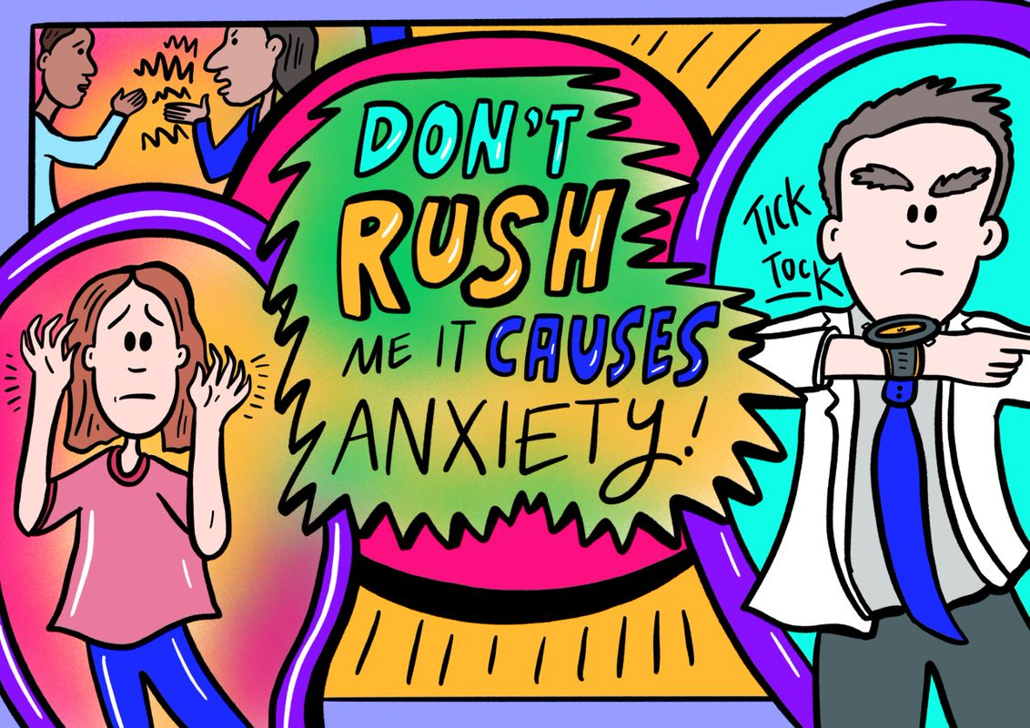
Theme 5: Previous negative experiences with the health care system, and experiences of their peers, influence how children and young people feel about health care today.

Slide 8
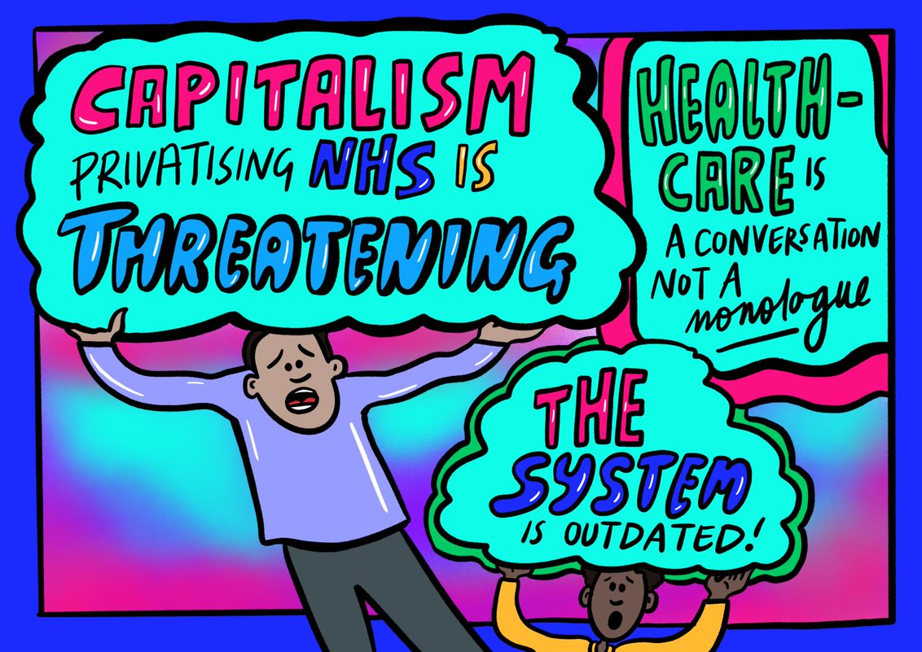
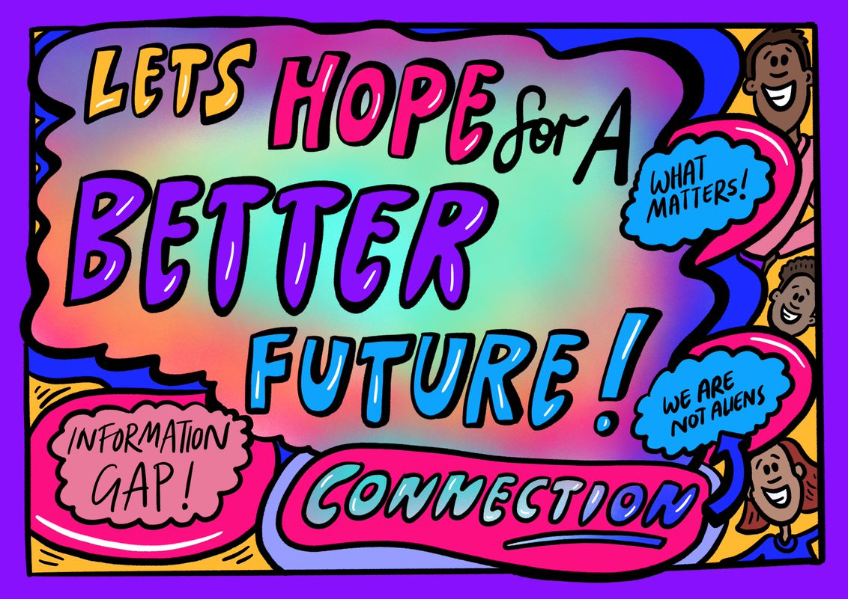
Theme 6: Young people are fearful about the future of the NHS.

Slide 9
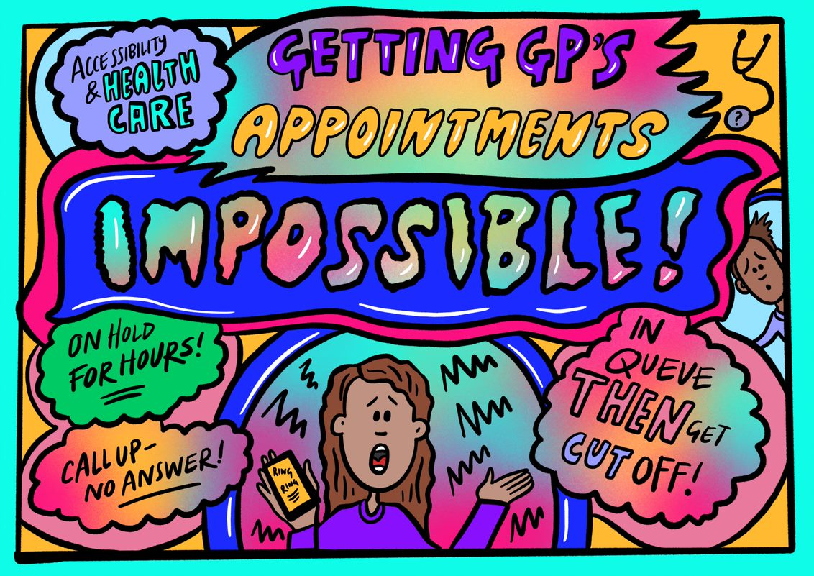
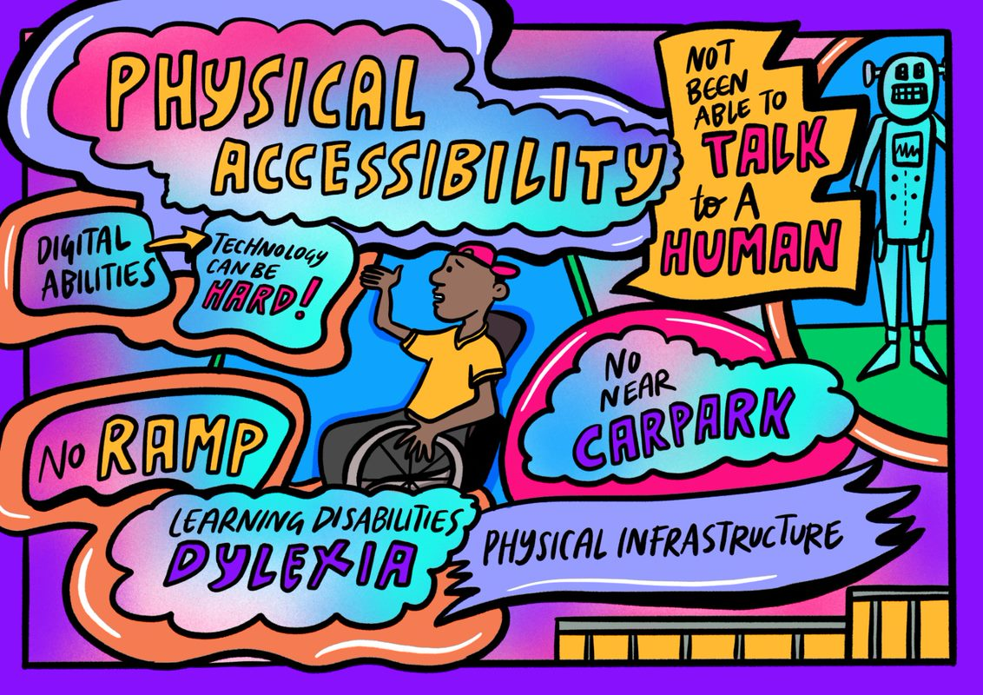
Theme 7: Young people find the health care system difficult to access and confusing, especially if you have a disability, learning disability and/or other support need.

Slide 10
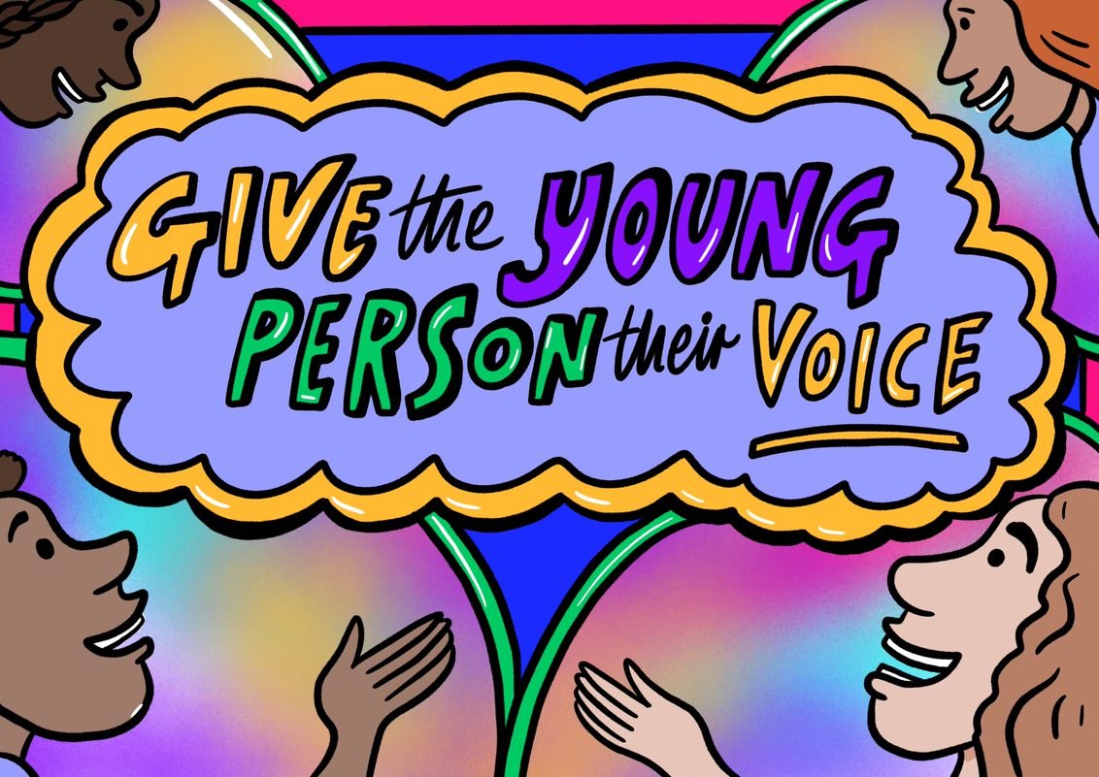
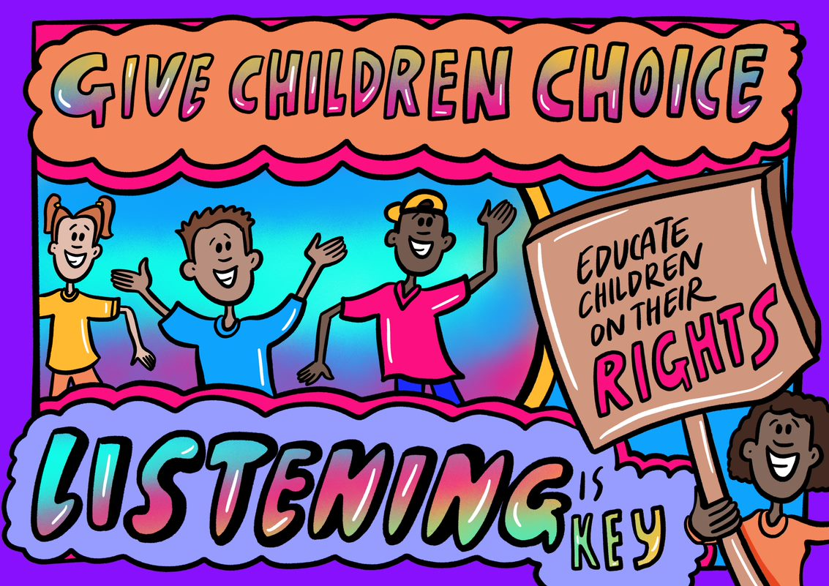
Theme 8: Young people want more choice over their health care: where, when, and who they see.

Slide 11
What did young people learn?

Slide 12
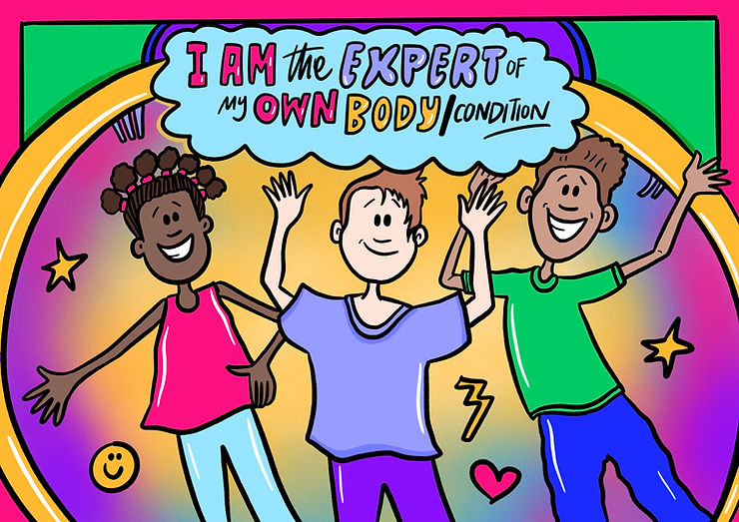
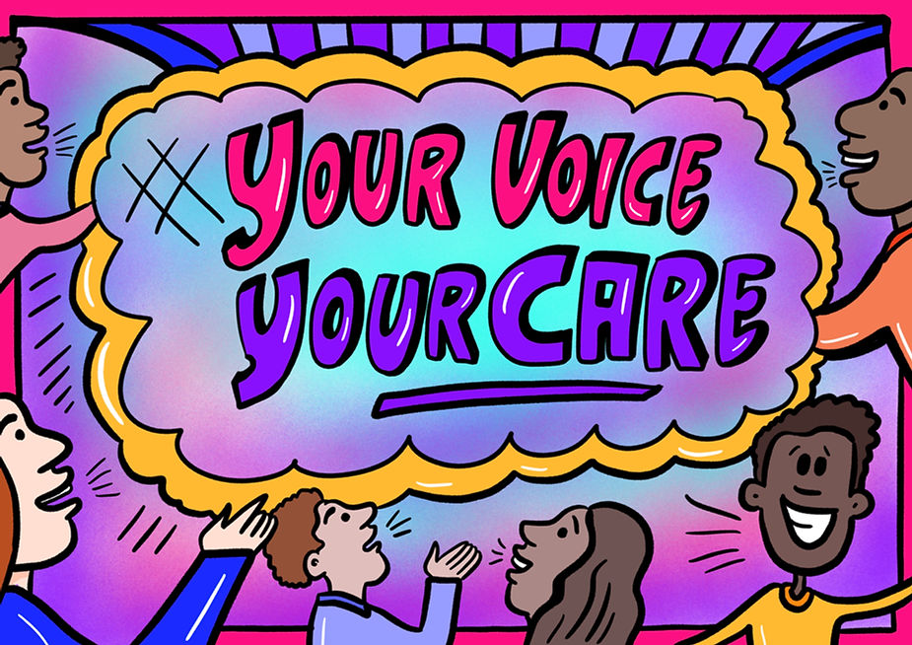
Young people learned that they have rights in their healthcare.
“ I have rights over my care and I am allowed to voice my opinions over my care .”
“[I learned] young people have access to a GP and medical records without parental consent.”

Slide 13
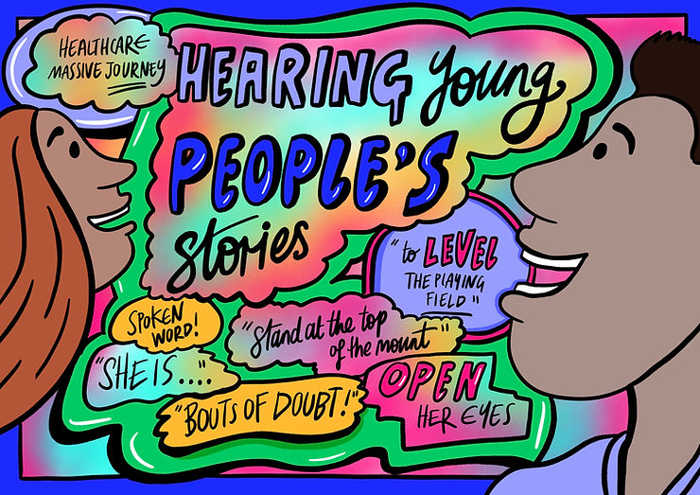
Young people learned the importance of sharing your stories with others and speaking up
“I loved hearing about other people's experiences.”
“[I learned] Everyone has their own problems, not just me.”
“[I learned] How much of a change we can make if we work together and hold these events more often. We need to continue dialogue and not do this type of work for nothing.”

Slide 14
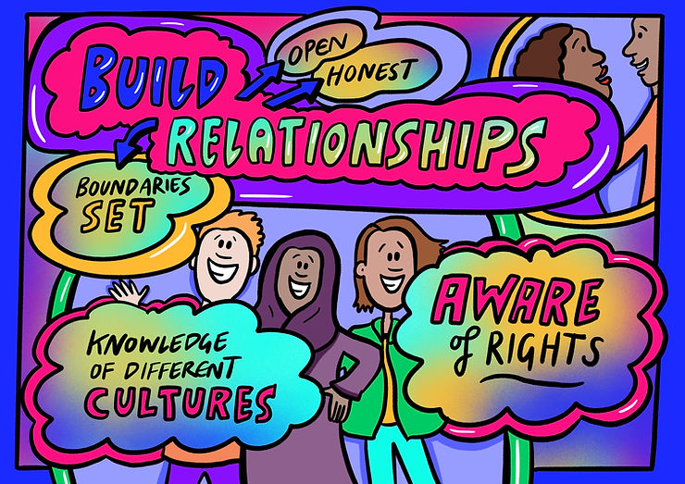
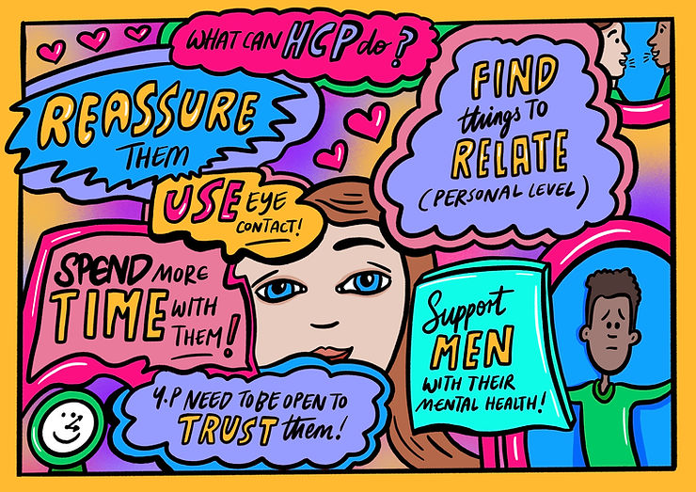
Young people developed a better understanding of the NHS
“New knowledge on confidentiality within the health sector.”

Slide 15
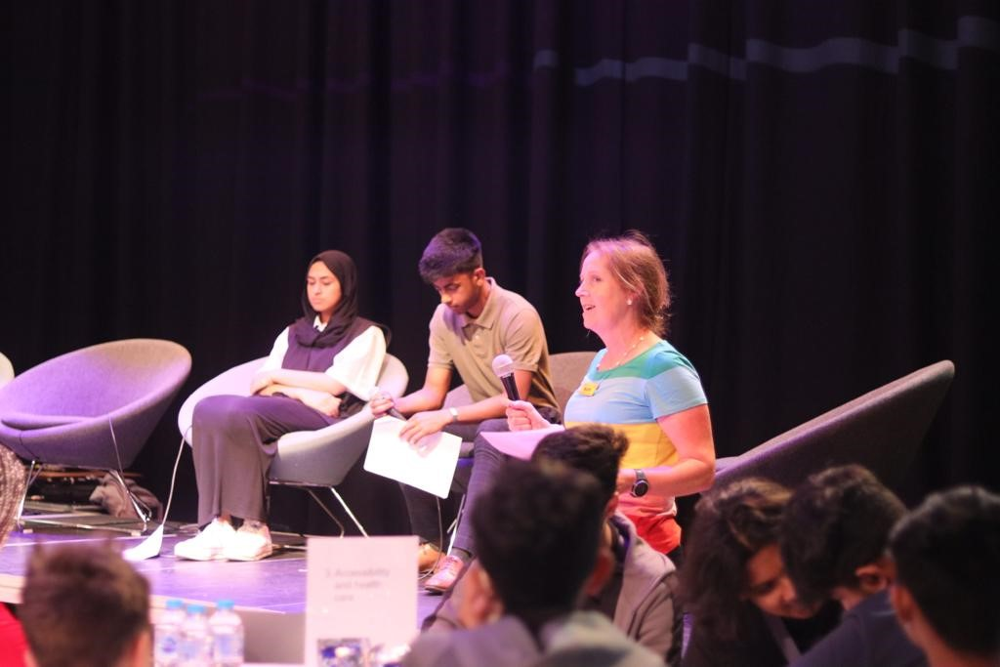
Young people felt they improved relationships with healthcare providers following this workshop
“Don't be afraid to trust adults working in the NHS.”
“I liked the vibe and networking opportunity.”

