Slide 1
North Central London Cancer Inequalities snapshot
TCST 8.10.19

Slide 2
Picture of the NCL population

Slide 3
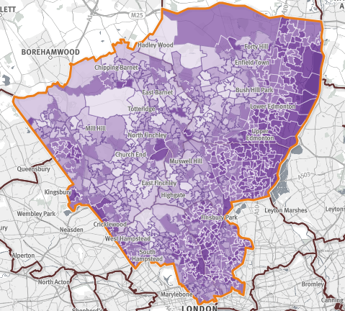
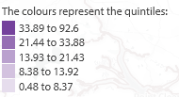
Picture of NC London
1.44m people
Levels of ethnic diversity vary across NCL, ranging from 32% of people in Islington from a Black and Minority Ethnic (BME) group to 42% in Enfield. The largest BME communities in NCL are Turkish, Irish, Polish and Asian (Indian and Bangladeshi) people. ‘Overall, around a quarter of people in NCL do not have English as their main language.’
Areas of significant deprivation – 3/5 boroughs –Islington Haringey and Enfield rank amongst the 20% most deprived local authority areas in the country. There is a wide spread of deprivation across NCL, but people tend to be younger and more deprived in the east and south.’
There are stark inequalities in life expectancy; for example, men in the most deprived areas of Camden live on average 10 years fewer than those in the least deprived areas
One prison – HMP Pentonville (Local prison holding 1256 men) in Islington
Drugs and alcohol – opiate and crack users estimated at 9798 in NCL using 2016-17 data (highest number in Islington with n= 2308 people)
People with SMI – There are an estimated 21,000 people in NCL with severe mental illness
Street homeless persons on CHAIN count n=1238 in NCL with highest number in Camden by far at n=702 (people seen living rough in boroughs, in the year)
© Crown copyright and database rights 201 Ordnance Survey 100016969
Source: SHAPE https://shapeatlas.net/place/
Notes:
London datastore for CHAIN count –2016-17 numbers https://files.datapress.com/london/dataset/chain-reports/2017-06-30T09:03:07.84/Greater%20London%20full%202016-17.pdf
http://www.northlondonpartners.org.uk/downloads/plans/NCL-Case-for-Change-September-2016.pdf
Population mobility - between mid 2011 and mid 2012. churn estimates
http://www.ourhealthiersel.nhs.uk/about/case-for-change/local-needs.htm

Slide 4
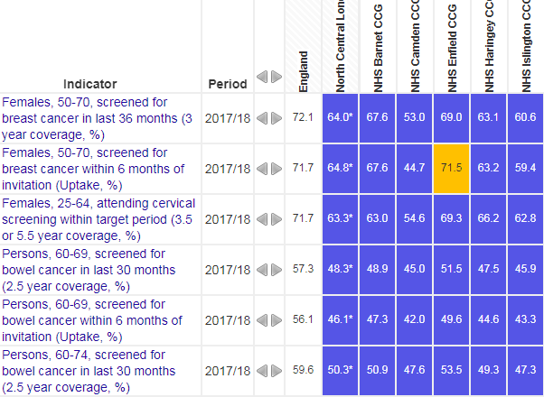
Cancer incidence: risk factors and screening, NCL
If we were to focus on minimising risk factors for cancer, we’d target alcohol in Islington, and smoking across NCL
If we had to focus on groups who are under-using screening services: BME populations, deprived groups
NCL is approximately 37% BME; Largest BME populations are in Enfield
To reach deprived areas we’d focus on Islington, Haringey, and Enfield
*
*
*
* = In 20% most deprived
Cancer screening coverage in NCL is below the England average across all 3 cancer screening programmes

Slide 5
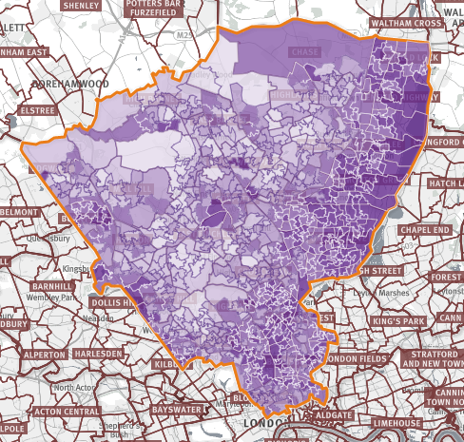
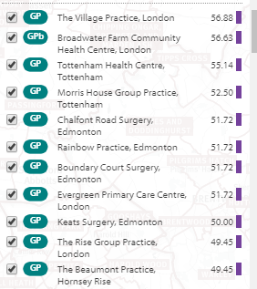
Where would we focus primary and community care efforts for cancer in NCL?
Where is the deprivation?
Which top ten GPs working in most deprived areas would we focus our efforts on in NCL?
Source: SHAPE atlas https://shapeatlas.net/place/
Notes:
https://shapeatlas.net/place/E54000028#11/51.6135/-0.1222/l-w18/b-07M,b-07R,b-07X,b-08D,b-08H/sc-pc,s-200/o-d,d/it-all,is-deprivation:,ii-deprivation_2015_IMD/rh-0,rdr-t

Slide 6
Physical health checks in severe and enduring mental illness (SMI) in NCL
Physical health checks for people with SMI are a good opportunity in primary care, to address cancer risks such as smoking and alcohol consumption. Although there are no data for Barnet, we can see that the lowest coverage is in Haringey and the highest is in Camden, for the physical health checks.
Notes:
https://www.england.nhs.uk/statistics/statistical-work-areas/serious-mental-illness-smi/

Slide 7
Cancer mortality in NCL
Cancer mortality in NCL is decreasing overall since 2002. There is a similar picture for men and women separately.

Slide 8
Summary – NCL population and cancer prevention
For prevention of cancer through modifiable risk factors, we would focus on reducing alcohol in Islington and smoking across all of NCL
If we needed to target cancer screening activity, we’d focus on Islington, Enfield and Haringey – the latter two for their high levels of ethnic diversity
For key locations to include in any STP inequalities plans – include HMP Pentonville (high levels of smoking, substance misuse), and inpatient mental health beds at Edgware Community Hospital, Chase Farm (BEH) and St Pancras (CANDI)
For physical health checks in people with SMI – Haringey has the lowest coverage with only 22% of people with SMI having their yearly check in primary care, though no CCGs have high rates of health checks.

Slide 9
Early diagnosis of cancer in NCL

Slide 10
Early diagnosis content
Screening and deprivation
Stage at diagnosis
Emergency presentations for cancer
One year survival

Slide 11
Early diagnosis - Cancer screening and deprivation in NCL
Breast screening
There was no relationship between deprivation and breast cancer screening coverage in NCL.
The lowest breast screening coverage was in Camden (53%) and the highest was in Enfield (69%)
Cervical screening
Similarly, there was no relationship between deprivation and cervical screening coverage in NCL.
The lowest coverage was in Camden (55%) and highest coverage in Enfield (69%)
Bowel screening
No significant relationship between deprivation and bowel screening coverage in NCL.
The lowest coverage was in Islington (47%) and highest coverage in Enfield (54%)
Source: PHE fingertips 2017-18 data https://fingertips.phe.org.uk/profile/cancerservices
Notes:
Data source: fingertips PHE 2017-18.

Slide 12
Early diagnosis - Stage of diagnosis in NCL
Data of staged tumours diagnosed between 2012-2017 show that:
A higher proportion of women were diagnosed at stages 1 & 2 than men (62% vs 49%).
Older people tended to have their cancer diagnosed at a later stage than younger people.
A higher proportion of white people have their cancer diagnosed late (stages 3&4) than for all other ethnicities.
Diagnosis at stage 1 or 2 decreases with increasing deprivation (see figure).
Note: unadjusted proportions do not take account of differences in case-mix (e.g. tumour site)
Data for this analysis is based on patient-level information collected by the NHS, as part of the care and support of cancer patients. The data is collated, maintained and quality assured by the National Cancer Registration and Analysis Service, which is part of Public Health England (PHE). http://ncin.org.uk/local_cancer_intelligence/tcst
Notes:
Data from the National Cancer Registration and Analysis Service in PHE were used.
Malignant tumours (C00-C97 excluding C44) diagnosed between 2012-2017 were included
Stage at diagnosis was defined in line with published annual statistics in ‘Stage breakdown by CCG 2017’ http://ncin.org.uk/publications/survival_by_stage

Slide 13
Early diagnosis - Stage of diagnosis NCL
There are small differences between CCGs in the percent of cancers diagnosed early (Stages 1 & 2); range 52-55% of all tumours*
All NCL CCGs have a similar or higher % of cancers diagnosed at Stages 1 and 2 than the England average (52%)
Enfield and Islington had the highest proportion of cancers diagnosed at Stages 1 and 2 at 55%
https://www.cancerdata.nhs.uk/stage_at_diagnoses * Includes un-staged tumours in denominator

Slide 14
Early diagnosis - Routes to diagnosis: emergency presentations
2012-16 data showed that:
Men were more likely to be diagnosed as an emergency than women in NCL (23% vs 19%)
The proportion of cancers diagnosed cancers diagnosed as an emergency increased with age >75
Emergency presentation was somewhat more common amongst white ethnicity (22%; 18% Asian; 20% Black; 22% Mixed/other ethnicity)
The proportion of cancers diagnosed through emergency presentation increases with increasing deprivation (see figure)
Data for this analysis is based on patient-level information collected by the NHS, as part of the care and support of cancer patients. The data is collated, maintained and quality assured by the National Cancer Registration and Analysis Service, which is part of Public Health England (PHE). http://ncin.org.uk/local_cancer_intelligence/tcst
Notes:
Data from the National Cancer Registration and Analysis Service in PHE were used.
Malignant tumours (C00-C97 excluding C44) diagnosed between 2012-2016 were included
Routes to diagnosis: http://ncin.org.uk/publications/routes_to_diagnosis
Note: unadjusted proportions do not take account of differences in case-mix (e.g. tumour site)

Slide 15
Early diagnosis - Emergency presentations by CCG
There are differences between CCGs in the % of cancers diagnosed through emergency presentation
The CCG with the lowest percent of emergency presentations is Barnet at 16%, and the highest is Enfield at 21%. Only Enfield (21%) has a higher proportion of emergency presentations of cancer than England (19%).
Emergency Presentation by CCG: http://ncin.org.uk/cancer_type_and_topic_specific_work/topic_specific_work/cancer_outcome_metrics

Slide 16
Early diagnosis - Breast cancer in NCL: 1 year survival in 2016
Whilst Barnet has the highest rates of 1 year breast cancer survival in NCL (97%), there are no significant differences between NCL CCGs
Notes:
https://www.ons.gov.uk/peoplepopulationandcommunity/healthandsocialcare/conditionsanddiseases/bulletins/indexofcancersurvivalforclinicalcommissioninggroupsinengland/adultsdiagnosed2001to2016andfollowedupto2017
Table 16: 1-year survival estimates (%) for breast, colorectal, and lung cancer, by calendar year of diagnosis: all adults (aged 15 to 99 years), Clinical Commissioning Groups, Sustainability and Transformation Partnerships, Cancer Alliances, England, 2001 to 2016, including confidence intervals

Slide 17
Early diagnosis - 1 year colorectal survival NCL 2016
1 year survival for colorectal cancer is worse than the NCL average in Haringey (79%), whilst 1 year survival Barnet is higher than average (87%)
1-year survival estimates (%) for colorectal cancer, by calendar year of diagnosis: all adults (aged 15 to 99 years), Clinical Commissioning Groups 2016
Notes:
https://www.ons.gov.uk/peoplepopulationandcommunity/healthandsocialcare/conditionsanddiseases/bulletins/indexofcancersurvivalforclinicalcommissioninggroupsinengland/adultsdiagnosed2001to2016andfollowedupto2017
Table 16: 1-year survival estimates (%) for breast, colorectal, and lung cancer, by calendar year of diagnosis: all adults (aged 15 to 99 years), Clinical Commissioning Groups, Sustainability and Transformation Partnerships, Cancer Alliances, England, 2001 to 2016, including confidence intervals

Slide 18
1 year survival lung cancer 2016 NCL
There were no significant differences in 1 year lung cancer survival between CCGs in NCL
Notes:
https://www.ons.gov.uk/peoplepopulationandcommunity/healthandsocialcare/conditionsanddiseases/bulletins/indexofcancersurvivalforclinicalcommissioninggroupsinengland/adultsdiagnosed2001to2016andfollowedupto2017
Table 16: 1-year survival estimates (%) for breast, colorectal, and lung cancer, by calendar year of diagnosis: all adults (aged 15 to 99 years), Clinical Commissioning Groups, Sustainability and Transformation Partnerships, Cancer Alliances, England, 2001 to 2016, including confidence intervals

Slide 19
Summary – Early diagnosis of cancer in NCL
Camden has the lowest percentage of cancer diagnosed at Stages 1 and 2 in NCL and Enfield has the highest
However, the highest proportion of cancers diagnosed as an emergency in NCL are found in Enfield (which seems to contradict the statement above)
These types of issues seem to be clustering in the most ethnically and economically disadvantaged areas of the NCL patch
1 year colorectal survival in Haringey is significantly worse than the NCL average

Slide 20
Cancer treatment in NCL

Slide 21
Outcomes for treatment for certain cancers
There are no data specifically on mortality from cancer operations for each hospital trust
However, there are data for different cancer types, which we can use to reflect on certain clinical outcomes:
Breast cancer
For Breast cancer, we used the NABCOP data on breast conserving surgery versus mastectomies for two groups - women aged 50-69 years and then women aged 70+ years
Breast cancer – we also looked at the proportion of women having a clinical nurse specialist CNS
Colorectal cancer
Colorectal cancer from 2018 NBOCA 90 day survival & 2 year survival https://www.nboca.org.uk/content/uploads/2018/12/NBOCA-annual-report2018.pdf
Lung cancer
LCCPOP https://www.rcplondon.ac.uk/projects/outputs/lung-cancer-clinical-outcomes-publication-2018-audit-period-2016
These data sources look at the 30 and 90 day survival data
As well as 1 year survival and length of stay in hospital

Slide 22
NCL Breast cancer in older women – type of surgery
The type of surgery used varies between trusts. Breast conserving surgery use is highest at North Middlesex, and lowest for women in UCL for both age groups. A caveat to this data is that it may not account for comorbidity (more complex women may not be able to have breast conserving surgery).

Slide 23
Breast cancer – having a clinical nurse specialist (CNS)
There is variation in the proportion of women having a CNS. For younger women (50-69yo) the proportion having a CNS was highest at the Whittington and BHR – (100%) and the lowest was at the Royal Free (65%).
For older women, the highest proportion of women having a CNS was at UCL (100%) and the lowest at the Royal Free (47%). Note that the number of women may be small and data reporting may be an issue.

Slide 24
Cancer waits NCL 62 day waits by age group
Amongst those on a 62 day (urgent referral) treatment pathway in NCL 2014-2017:
The oldest (85+) and youngest (0-44) age groups more often had shorter pathways to treatment following referral than those age groups in between.
Note: unadjusted proportions do not take account of differences in case-mix (e.g. tumour site)
Data for this analysis is based on patient-level information collected by the NHS, as part of the care and support of cancer patients. The data is collated, maintained and quality assured by the National Cancer Registration and Analysis Service, which is part of Public Health England (PHE). http://ncin.org.uk/local_cancer_intelligence/tcst
Notes:
Data from the National Cancer Waiting Times Monitoring Dataset, linked to National Cancer Registrations data, was used
Patients diagnosed with a malignant tumour (C00-C97 excluding C44) 2014-2017 and recorded as being on a 62 day pathway were included
Adjustments were made to waiting times in line with CWT guidance

Slide 25
Cancer waits NCL 62 day waits by sex
Between 2014-2017 in NCL:
Men on an urgent referral for suspected cancer were more likely to have longer pathways to treatment than women (figure)
Those with no recorded ethnicity were most likely to have shorter pathways to treatment in NCL, followed by those of white ethnicity.
There were no significant differences in waiting time to treatment by deprivation in NEL
Note: unadjusted proportions do not take account of differences in case-mix (e.g. tumour site)
Data for this analysis is based on patient-level information collected by the NHS, as part of the care and support of cancer patients. The data is collated, maintained and quality assured by the National Cancer Registration and Analysis Service, which is part of Public Health England (PHE). http://ncin.org.uk/local_cancer_intelligence/tcst
Notes:
Data from the National Cancer Waiting Times Monitoring Dataset, linked to National Cancer Registrations data, was used (approx. 80% of registered tumours link to a CWT record)
Patients diagnosed with a malignant tumour (C00-C97 excluding C44) 2014-2017 and recorded as being on a 62 day pathway were included
Adjustments were made to waiting times in line with CWT guidance

Slide 26
Summary – cancer treatment NCL
The NABCOP breast audit data show that the use of breast conserving surgery in older women in NCL was highest in North Middlesex and lowest at UCL
The data also showed that having a clinical nurse specialist (CNS) varies across the trusts in NENCL – this was consistently lowest for Royal Free for women 50-69 years (65% had a CNS) and 70+ years (47% had a CNS)
Women diagnosed with cancer on an urgent referral (62 day) pathway are more likely to have fewer days from referral to treatment than men

Slide 27
Personalised care for cancer NCL

Slide 28
Personalised care – comorbidities NCL
Measuring comorbidity is a good way to understand the complexity of medical needs faced by cancer patients. The Charlson score indicates a burden of comorbidity (combining number of conditions, risk of mortality and/or resource use) where patients with no comorbidities have a zero score and an increasing burden of comorbidity is represented by a higher score. A study of prevalent cases in London & W Essex from 2007-14 showed little differences in comorbidity between different STPs.
Across London there is increased comorbidity with increasing age; 6% of under 60s compared to 25% of over 80s; 12% of cancer patients overall have comorbidity.
The % of patients with comorbidities also increases with increasing deprivation. The highest % with a comorbidity score >0 occurs in the most deprived groups in Barnet and Enfield.
Comorbidity at diagnosis for those living with cancer in London: http://ncin.org.uk/local_cancer_intelligence/tcst

Slide 29
Personalised care – household bills arrears GLA data 2018-19
Recent data from the GLA survey highlight the London assembly areas with highest levels of people living with household bills arrears.
For STPs, this might help target support services, and should prompt hospital services to think about debt with patients in particular areas.
For NCL we would focus on Enfield and Haringey, where 9% of people have household bills arrears
Notes:
https://s3-eu-west-1.amazonaws.com/londondatastore-upload/postcode_sectors_combined_2011_A4_v2ii.png

Slide 30
Personalised care – psycho-oncology NCL
Psycho-oncology is a ‘multi-disciplinary speciality focusing on the psychological and mental health care of people affected by cancer, carers and families, contributing through direct and indirect care to improving clinical outcomes, patient experience and quality of life’ (The Psychological impact of cancer: commissioning recommendations, pathway and service specifications on psychosocial support for adults affected by cancer. TCST May 2018)
There is access to Psychological support for cancer patients at each of London’s acute trusts in NCL.
Notes:
https://www.healthylondon.org/wp-content/uploads/2018/05/Psychological-support-for-people-affected-by-cancer-May-2018.pdf

Slide 31
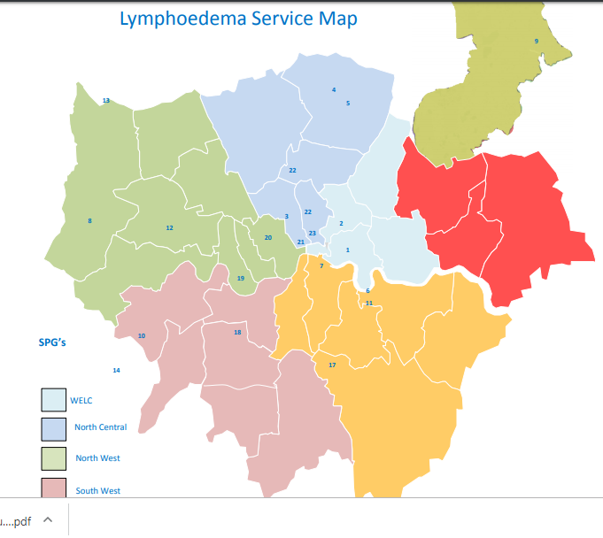
Personalised care – Lymphoedema services NCL
Service Mapping by TCST 2016
Using estimates of 1.33 persons with Lymphoedema per 1000 population (cancer and non cancer) we would estimate that there are 1,915 people with lymphoedema in NCL
In NCL there are service
gaps in Barnet
Notes:
file:///C:/Users/lannik/Downloads/Commissioning%20guidance%20lymphoedema%20August%202016%20(1).pdf

Slide 32
Summary personalised care in NCL
Comorbidity in cancer patients in NCL is highest in older people, and deprived groups in Barnet and Enfield
Household bills arrears are high in Enfield and Haringey
Lymphoedema services: there are service gaps in Barnet

Slide 33
All the work we do with our partners moves us closer towards our goal to make London the healthiest global city.
www.healthylondon.org
england.healthylondon@nhs.net
@healthyLDN

